Slide 1

Controlling a UR Robot Arm inside a Custom Gazebo World
Abd alrahman alhindi

Slide 2
Work flow
Setting up ROS 2 Jazzy + Gazebo Harmonic
Following the official Gazebo Project Template Guide
Installing and running a universal robot (UR) simulation
Launching a custom world(drone race track)
Controlling the UR arm using python node

Slide 3
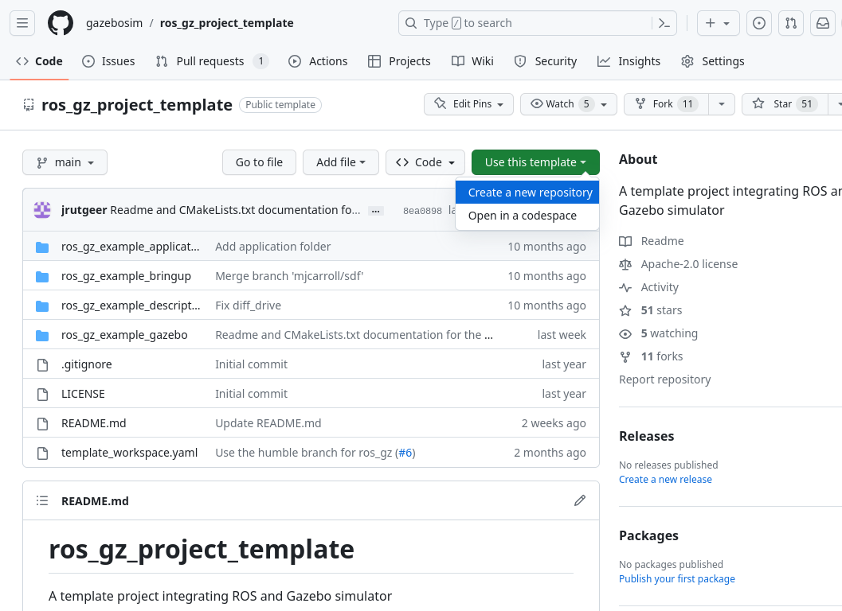
2️⃣ Setting up the Base (Gazebo + ROS 2 Template)
• I started learning Following the official Gazebo Project Template Guide tutorial.
• I learned how to link ROS 2 Jazzy with Gazebo Harmonic.
• I learned how to organize the Workspace structure which includes: worlds, robot descriptions, example apps.

Slide 4
🧩Important Environment Setup
• Ros 2 commands come from
• gz(gazebo)commands come from
Each tool needs to be sourced before use.
ROS 2 and Gazebo “meet” through the template’s integration layer.
/opt/ros/jazzy/setup.bash
/usr/share/gz/setup.sh

Slide 5
🚀Running ‘’World’’
• Used ros2 pkg prefix + find to locate the example world.
• Chosed the .sdf world file automatically following the command:
This will open the example ‘world’.
fWORLD=$(find "$PREFIX/share/ros_gz_example_gazebo" -name '*.sdf' | head -n1)
gz sim -r -v 4 "$WORLD"

Slide 6
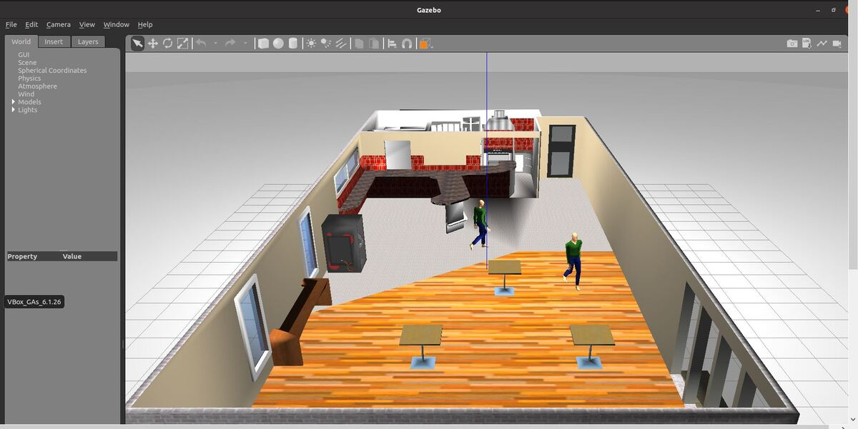
🌍Understanding What a “World” Is
• A world is a 3D simulation environment.
• Defined using SDF (Simulation Description Format).
It includes: ground plane-light-models-robots.
Each <model> in the file adds something to the environment.

Slide 7
📁Where worlds live
• Worlds stored inside packages under:
Example worlds come from:
We locate them using:
Item | TitoDescription
World file (.sdf) | Defines environment
Model files | Robots or structures
Package prefix | Tells ROS where to look
install/<package>/share/<package>/worlds/
ros_gz_example_gazebo
ros2 pkg prefix <package>

Slide 8
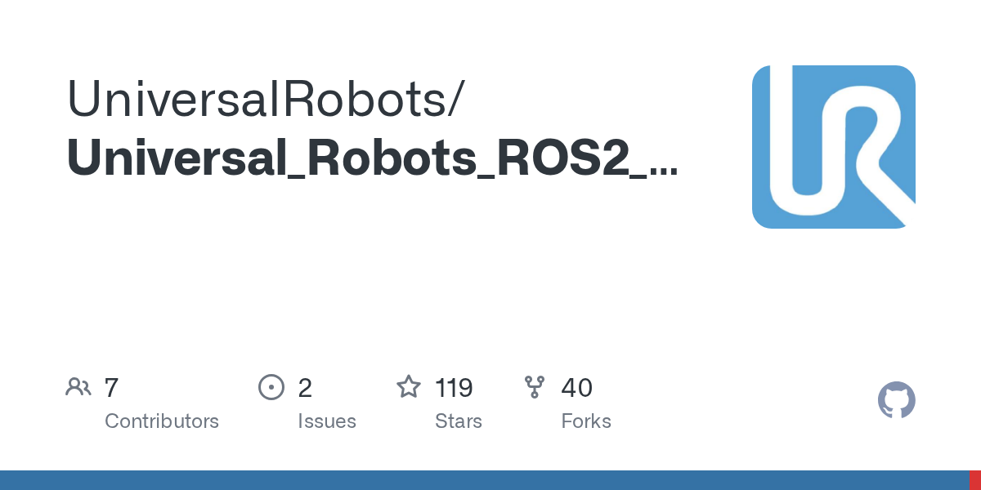
🤖Moving to Universal Robots Simulation
• Now we switch to the official UR Ros 2 gazebo simulation package.
Fully compatible with ROS 2 Jazzy + Gazebo Harmonic.
It includes:
It provides ready-to-use simulation for:
-UR3e
-UR5e
-UR10e
-Controllers.
-Launch files.
-Robot configs.

Slide 9
📘What is the content of the package?!
• Packages are structured like a real industrial robot simulation.
The ros2 branch provides out-of-the-box support for Jazzy.
It works perfectly with created workspace.
‘’This simulation used by many universities and companies.’’
Simulation includes:
-Joint controllers.
-Hardware interface.
-Gazebo integration plugins.

Slide 10
🏗️Building the UR Simulation
cd ~/project_ws
colcon build --symlink-install
source install/setup.bash
--symlink-install:
Let us edit files inside src/ without rebuilding
Built inside the workspace to keep everything consistent
Sourcing install/setup.bash
let edit files inside src/ without rebuilding

Slide 11
🚀Launching the UR Simulation
ros2 launch ur_simulation_gz ur_sim_control.launch.py
Launches Gazebo Harmonic.
Confirms ROS 2 ↔ Gazebo ↔ UR bridge working properly
Loads the UR5e or UR3e or UR10e robot
Brings up joint controllers + Gazebo plugins

Slide 12
🔗What is symlink?!
build --symlink-install
It is a pointer to another file or folder.
Points the installation directly to the workspace files
Perfect for working on simulation configs and Python scripts
Lets ud edit files inside src/ and see the effect immediately
Saves a lot of time while learning and experimenting

Slide 13
🦾Exploring the Controller Interface
• We Verify which ROS 2 controllers are available.
• We Check active control interfaces using ROS commands:
We identify the trajectory and state controllers provided by the UR simulation.
ros2 topic list | grep joint_trajectory
ros2 control list_controllers

Slide 14
📋Controllers we found
scaled_joint_trajectory_controller
joint_state_broadcaster
publishes the robot’s current joint positions
receives joint trajectory commands and moves the arm smoothly

Slide 15
➡️what is scaled_joint_trajectory_controller?!
• It is the main interface for sending motion commands.
• Accepts Joint Trajectory messages
Ensures smooth, scaled, safe execution
Converts high-level motion commands → actual joint movements
This is where your Python control node will publish commands

Slide 16
🦾Why This Controller Matters?!
• All UR motion control goes through this controller
• Python scripts must publish to:
Without this controller active, the script will not move the robot
It bridges your Python node → ROS 2 controller → Gazebo robot
/scaled_joint_trajectory_controller/joint_trajectory

Slide 17
💻Writing Python ROS 2 Control Node
• we create Python ROS 2 node to control the UR robot.
• Published a JointTrajectory message to the controller topic
File name example: ur_rotate_demo.py

Slide 18
🐍What the Python Node Does
The script performs the essential ROS 2 steps:
• Imports rclpy
• Creates a publisher to:
Builds a JointTrajectory message
Sends target joint values to the controller
Makes the robot arm move in Gazebo
/scaled_joint_trajectory_controller/joint_trajectory

Slide 19
⚙️Core Python Logic
msg = JointTrajectory()
msg.joint_names = [...]
point = JointTrajectoryPoint()
point.positions = [1.5, -1.5, 1.5, -1.0, 1.5, 0.0]
point.time_from_start.sec = 6
msg.points.append(point)
pub.publish(msg)
joint_names tells the controller which joints to move
positions defines the final target angles
Publish → Gazebo executes the movement
time_from_start defines motion duration

Slide 20
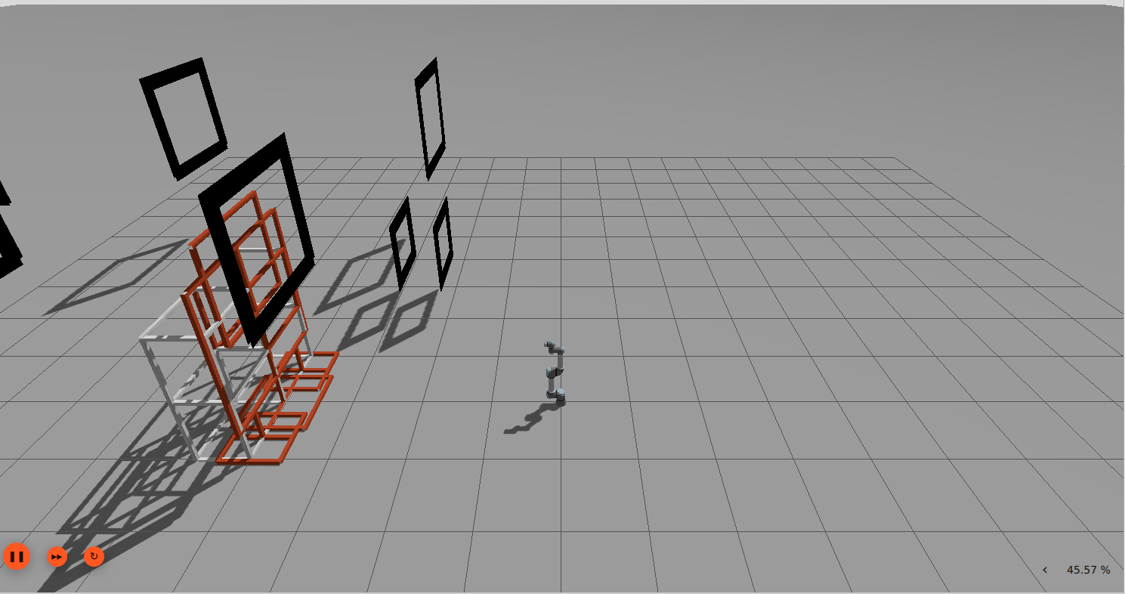
🌍Integrating a Custom Gazebo World
Since we are able to create a fully custom ROS 2 motion command
•we move into Integrated a custom world from the Gazebo model library
• World used: Drone Race Track.
Goal: use a world environment with UR robot simulation.

Slide 21
📁Where You Placed the Custom World?!
We place the world file under:
~/project_ws/src/worlds_extra/gazebo_models_worlds_collection/worlds/
Why this location?
• Keeps third-party worlds organized
• Ensures easy access from launch files
Preserves project structure for presentations & sharing

Slide 22
🚀Launching the Simulation with the Custom World
WORLD=~/project_ws/src/worlds_extra/gazebo_models_worlds_collection/worlds/drone_race_track_2018_actual_with_gatepapers.world
ros2 launch ur_simulation_gz ur_sim_control.launch.py world_file:=$WORLD
WORLD=
sets the full path to the world file
world_file:=
passes it into the UR launch system
Gazebo loads the world AND the UR robot together

Slide 23
⚠️The Overlap Problem
• The robot spawned at the same position as the drone race track world.
• This caused intersection / collision at load time
This is normal when combining:
an external world file
with a robot that has a fixed spawn pose
Note: This happens because SDF worlds include fixed model poses

Slide 24
🛠️Fixing the Overlap (Editing Poses)
Editing the SDF pose of the race track
Changing the <pose> values to shift models
Moving gates and objects until the robot and world no longer intersected
Understanding how Gazebo positions worlds using (x, y, z, roll, pitch, yaw)

Slide 25
📐Automating World Adjustments
We created a Python script: shift_drone_gates.py
Its purpose:
Automatically shift all gate models
2. Apply consistent offset (+3 m in X direction)
3. Regenerate a corrected world version
Note: This saved time compared to editing every SDF <pose> manually.”

Slide 26
🔁Automating Continuous Motion
We upgraded our Python script into a looping motion controller: ur_back_and_forth.py
It alternated between:
Pose A (Home)
Pose B (Rotated)
How?
Using a timer callback
Sending a new trajectory every few seconds
point.time_from_start = Duration(sec=2)
self.timer = self.create_timer(4.0, self.send_next_trajectory)
Robot moves to the new pose in 2 seconds
Timer triggers every 4 seconds
Creates smooth, rhythmic back-and-forth motion

Slide 27
👀Resulting Behavior
The UR arm now moves continuously
Motion is smooth and responsive
You can see the robot cycling between poses inside the drone track

Slide 30
Slide testuale concisa
Sottotitolo della slide
Testo breve ed importante
Livello 2
Livello 3
Nota a piè di pagina

Slide 31
🧩🤖🌍Creating the Final Working Environment
We now have:
Clean drone world
UR arm placed correctly
Gazebo running smoothly
Controller active
🎯Result: The robot moved successfully inside the drone world

Slide 32
Slide testuale concisa
Testo breve ed importante
Livello 2
Livello 3
Nota a piè di pagina

Slide 33

Inserimento di un’immagine
Didascalia della foto

Slide 34
Formattazione tabella
 | Titolo 1
Titolo A | Contenuto
Note | Nota 1

Slide 35
Immagine e testo
Didascalia esplicativa dell’immagine

Slide 36
Immagine e testo
Didascalia esplicativa dell’immagine

Slide 37
Slide a due sezioni
Sezione 1
Sezione 2
Testo sezione 1
Testo sezione 2

Slide 38
Slide a 3 sezioni
Sezione 1
Sezione 2
Sezione 3
Testo sezione 1
Testo sezione 2
Testo sezione 3

Slide 39
Slide riassuntiva per punti
Sottotitolo della slide
Punto 1
Punto 2
Punto 3

